Slide 1
CYB 110 Cybersecurity and privacy module 11 – OS security Jim Alves-Foss and Jia Song

Slide 2
Security functions in OS
Topics:
An overview of operating systems.
System resources which need protection from the OS.
Security functions provided by OS
Virtualization
Segmentation
Paging
Tagged architecture
Address Space Layout Randomization
Learning Outcomes:
Upon completion of this lesson:
Students will be able to identify the system resources which require protection by the operating systems.
Students will be able to describe the security functions provided by the OS.

Slide 3
Operating systems
An operating system is a program that works as an intermediary between the user applications and the computer hardware.
The OS manages the hardware resources, so that it provides an environment in which a user can execute programs and software easily on a computer system.
Modern operating systems (and even some older systems) are multiuser and multiprocessing systems.
The OS also manages permissions for the users, and resources it manages (files, processes, devices).

Slide 4
OS Overview
A user executes a program that generally consists of one process.
A process is assigned system resources
Memory the program can use
State (registers, program counter, stack pointer)
access to devices and communications
A process can create other processes.
The operating system keeps track of all processes by using a process table.

Slide 5
OS Overview (cont.)
The operating system switches control back and forth between processes, allocating, deallocating, and reallocating resources each time a different process is activated.
A process consists of one or more threads.
Each thread is a separate execution unit (so they can execute in concurrently, and truly in parallel especially on a processor with more than one CPU core).
In a game, you can have thread managing the characters, threads for the graphics display (modern video cards have own GPU with many threads, each allocated to part of the screen), thread for user input..

Slide 6
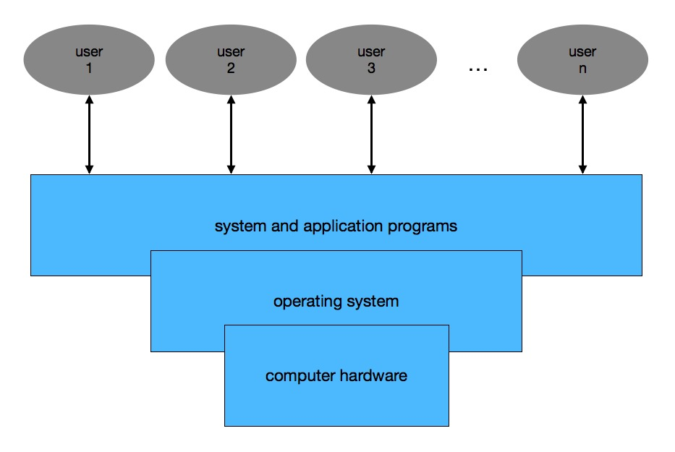
OS Overview

Slide 7
Discussion:
If there are multiple users sharing an operating system:
What needs to be protected?
What protections are provided by the operating system to protect different users’ data?

Slide 8
Objects that need protection
Memory
Sharable I/O devices, such as disks
Time-shared I/O devices, such as printers (one program/user at a time)
Programs
Networks
Files

Slide 9
Security Features of Ordinary Operating Systems
Authentication of users
Protection of memory
File and I/O device access control
Allocation and access control to general objects
Enforcement of sharing
Guarantee of fair service
Interprocess communication and synchronization
Protection of operating system protected data

Slide 10
Features of Trusted OS
Identification and Authentication
Mandatory Access Control (MAC)
Object Reuse Protection
Complete Mediation
Trusted Path
Accountability and Audit
Audit Log Reduction
Intrusion Detection

Slide 11
Trusted OS Design
Kernelized Design
Coverage
Separation
Unity
Modifiability
Compactness
Verifiability

Slide 12
Trusted OS Design
Reference Monitor (it is NEAT)
Non-bypassable
Evaluatable
Always Invoked
Tamperproof
Trusted Computing Base
The collection of system components necessary to enforce the security policy
the larger this is, the harder it is to evaluate

Slide 13
TCB Functions
The TCB must at least manage
Process activation
Execution domain switching
Memory Protection
I/O operation

Slide 14
Security Features in modern OS
User authentication.
Memory protection.
Interface to hardware.
Allocation of objects.
Access control to objects, file and I/O devices.
Protection of operating system data and code.

Slide 15
Security functions provided by modern OS
Access control
A subject is permitted to access an object in a particular mode.
Audit
A log of which subject accessed which object is maintained.
Separation
Separation can be supported by space, time, access control, or cryptography.
Virtualization
Virtualization provides a simulated environment by VM.
Hardware protection of memory
Segmentation, paging, address randomization, …

Slide 16
Virtualization
With virtualization, the OS presents each user with just the resources that user needs.
The user has access to a virtual machine (VM), which contains those needed resources. The user cannot access to the resources outside the VM.
Virtual machine (VM) - Software that allows a single host to run one or more guest operating systems.
A hypervisor, or VM monitor, is the software that implements a VM.

Slide 17
Virtualization security
Concerns:
How to ensure that the programs running within a guest OS may only access to the resources allocated to it?
Is it possible for unauthorized parties to access the image or screenshot of the VM?
How to secure the VM monitor or hypervisor?
How to control privileged access to some of the program resources in the guest OS?

Slide 18
Separation
Separation can be supported by space, time, access control, or cryptography.
• separation by space
• Use different physical resources for different users
• Easy to implement, but expensive
• separation by time
• Execute different users’ programs at different times
• Easy to implement, time consuming
• separation by access control
• access control applied to objects
• needs maintain from the OS
• separation by cryptography
• Encrypt data so other users cannot read it without the decryption key
• Complex

Slide 19
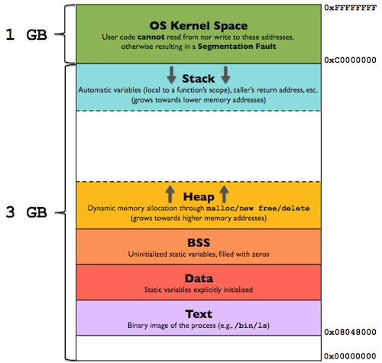
Memory
Example memory Layout of a program in a 32-bit system.

Slide 20
Hardware Protection of Memory
Preventing one process from affecting the memory of other processes
Built-in hardware protection mechanisms are common.
fence
fence register
base/bounds registers
segmentation
paging
combined paging with segmentation
tagged architecture
address space layout randomization (ASLR)

Slide 21
Fence
Introduced in single-user operating systems
Goal
Prevent a user program from interfering the OS code/data
Methods
Provides a “fence”, a predefined memory address
User is limited to one side of the “fence”
OS is protected by the “fence”
Problem
It was designed for single-user OSs. If there are more than one user in the OS, there is no protection for a user from the other users.
If the OS is getting bigger, the address of the fence cannot be changed.

Slide 22
Fence Registers
Goal
Prevent a user program from interfering the OS code and data
Methods
The location of the “fence” is specified using a register.
The address of the “fence” can be changed.
User is limited to one side of the “fence”
OS is protected by the “fence”
Problem
It was designed for single-user OSs.
If there are more than one user in the OS, there is no protection for a user from the other users.

Slide 23
Base/Bounds Registers
Goal
Protect a user resources from other users by using a pair of base register and bound register.
Mothed
Base register - provides a lower bound for programs
Bounds register – provides a upper bound for a programs
All addresses inside a program are offsets from the base address
Problem
Base/bounds register values must be changed during context switch to specify the correct space.
it does not separate program and data sections

Slide 24
Segmentation
Goal
Divide a program into multiple pieces, each of them may have different access rights
Method
Segmentation divides a program into several pieces, such as code segment, data segment…
Different piece may have different access rights associated.
A segment translation table is maintained to locate different pieces.
A memory location pair <name, offset>
Name: name of the segment
Offset: offset within the segment

Slide 25
Benefits of using segmentation
Benefits
The OS can place or move any segment to any location.
Each segment may has its own access right.
OS can check the access right when accessing the segment.
Two or more users can share access to a segment, with different access rights

Slide 26
Limitations of segmentation
Limitations
OS needs to maintain a segmentation translation table to keep track of the locations of segments.
The length of segment must be maintained, and compared with every address generated
Segmentation makes the memory space fragmented.

Slide 27
Paging
Goal
Divide a program into equal-sized pieces
Method
Memory is divided into equal-sized units, called pages.
All pages are of the same size.
Each address in a paging scheme is represented by a pair <page, offset>
Memory will not be fragmented.
Problems
Access rights can only be applied on pages.

Slide 28
Combined Paging with Segmentation
Segmentation and paging can be combined.
Programs can be broken into multiple segments, and the segments are used to fill pages.
Benefits
protection rights can be applied to segments.
paging makes the implementation efficiently.
Segments can be accessed through paging.
Problem
Extra work on maintaining tables to keep track of the locations of each segment.

Slide 29
Tagged Architecture
In the tagged architecture, metadata can be associated with every word of memory to hold information about the tagged data, such as security levels, memory types, access rights.
The metadata can be treated as a tag. It can be one bit of data or several bits.
The tags are checked every time an instruction accesses that tagged data.
Limitation:
Expensive
Requires extra work on tag checking and propagation.

Slide 30
ASLR
Address Space Layout Randomization
Each time the program is loaded, different addresses are used:
The stack can have a different start address
The program (if compiled as “position independent code” (PIC)) can have a different start address
In 32-bit systems, there is still not enough randomization.
If code is not PIC, there is not enough randomization.
This prevents attacks that rely on precise addresses
Attacks that use relative offsets, still work unless we “shuffle” the program.

Slide 31
Operating System Hardening
The concept of making sure your operating system is more secure
See here for benchmarks (guides for different OS’s):
https://www.cisecurity.org/cis-benchmarks/
Hardening
Remove unnecessary software | Remove unneeded services | Alter default accounts
Use principles of least privilege | Perform updates | Implement logging and auditing

Slide 32
Remove All Unnecessary Software
Every application on your device, is a potential target of attackers.
Each place/application/protocols/device/service that an attacker can access is part of what we call the “attack surface”.
If you are running a webserver, you need to have all of the server software and administration software, but definitely not games or standard desktop applications.
You need to be careful to not remove too much, since an application may be used by an essential application
Keep “production machines” separate from “development” and “testing” machines. Developers may download a lot of software for testing and then let it sit, unpatched.

Slide 33
Remove all unessential services
Many operating systems ship with a lot of services.
They are not sure what the customer needs/wants and want to support the whole marketplace.
If you turn off the wrong services, you can break things. (See CIS benchmarks) as a guide.
How do you know what is running?
You can use scanning tool such as nmap, or netstat

Slide 34
Alter/Remove Default accounts
What accounts are installed in your system?
(in Linux, look at /etc/passwd or use “getent passwd”)
Are these needed?
Do they have default passwords?

Slide 35
Apply principle of least privilege
The “principle of least privilege” state that users/program should only have the privileges they need to get their job done.
This first place to apply this is with administrator or root accounts.
Limit who has access to them.
Also, do not normally run in an execution mode where you automatically have these permissions. For Linux, you can use the “sudo” command and “sudoers” options. For windows, it will ask for credentials to install software.
Second place is to put good access control permissions on configuration and log files.
Third, make sure default access to user files is for user only.

Slide 36
Perform updates
Organization should have process in place to install updates.
Personal computers and workstations can be configured to do this automatically. Most operating systems and software now support this. And put out regular, free, security patches.
Warning: some may reboot computers. Occasionally they “break” something
Production machines need to be tested first. Usually this involves having test machines you perform updates on first, then run your full test suite, before making it go live.
This is especially needed when upgrading (upgrade from Windows 7 to Windows 10 took a lot of testing for some companies)

Slide 37
Turn on auditing and logging
You need to turn on, configure, and review audit logs.
Each system has its own mechanisms for doing this. The benchmark guides should help.
There are different tools companies use to check and review the logs.

Slide 38
Some Links
From Microsoft:
Windows 10 Security
The CIS Benchmarks (again)
https://www.cisecurity.org/cis-benchmarks/

Slide 39
Protecting against malware
Malware is “bad software”, and is a generic term for different type:
Viruses – modifies legitimate software, adding bad code. Usually installed by other malware the user executes. (computer virus)
Worms – self replicating code, transfers itself from machine to machine.
computer worm, Iloveyou worm, SQL Slammer
Trojans – masquerade as legitimate programs, but with some malicious intent. Usually arrives by email, or from a malicious website. This is the malware of choice these days. (Trojan , Remote access Trojans (RATs)) Easy to write: cyber criminals routinely produce and hawk Trojan-building kits)
Hybrids – Combination of trojan, worm and maybe virus. (Bots are trojan/worm combinations). (Botnets)

Slide 40
Protecting against malware (2)
Ransomware – Probably a trojan, but specific intent to encrypt your data and then hold it hostage until you pay. (Ransomware)
Fileless Malware – A specific way of deploying malware. Does not use files or file system, but only spread in memory. Typically corrupt a running process (through a vulnerability) to create a new subprocess, or use built in legitimate tools. 50% of all modern malware does this – it is harder to detect. ( fileless attacks)
Adware – Exposes you to unwanted advertisements – some of which can redirect you to a “look-a-like” website, or to deliver malicious content. (adware)
Malvertising – Not to be confused with adware, malvertising is the use of legitimate ads or ad networks to covertly deliver malware to unsuspecting users.
Spyware is most often used by people who want to check on the computer activities of loved ones.

Slide 41
Antimalware tools
“Antivirus” – tools that scan for copies of viruses (now check for all types of malware)
Often use signatures (pattern matching) or heuristics (best guess patterns) to detect malware
Can scan downloaded files and programs, check email, check websites
Malware writes obtain and use these tools to see if they can get around them.
Malware writers will use “polymorphic” code (many different versions of same code), self decrypting code (only decrypts after scanner runs), code obfuscation (rearranges code).
Malware writers will try to “turn off” any antimalware running in the system. (Solarwinds attack, “Starburst”, reconfigured default services, and upon reboot, the system was no longer secure. Also scanned system for many different types of anti-malware)

Slide 42
Executable space protection
Operating system can enable execution space protection
Address Space Layout Randomization
Non-executable stack
Stack smashing protection (usually done by the compiler)
(Smashing the stack for fun and profit)
Most operating systems and hardware support these.

Slide 43
Software firewalls and host IDS
Firewalls and IDs do not have to be just on the network (see chapter 10)
These exist at the network interface between the OS and the network card
Usually, a subset of what you find in a network-based solution.
Host based software firewalls can prevent local software from opening network communication channels.
A network firewall will not know if a request to open a connection with a remote machine is legitimate or not. It doesn’t know what the user is doing, and it could look like a normal web request.
Host-based IDS look at software and user behavior and access patterns

Slide 44
OS Security tools
Many of the network security tools can be used for OS security (nmap, netstat). Assume your machine IP is 192.168.1.100
https://nmap.org/download.html (Works on Windows, Mac and Linux)
Try nmap 192.168.1.100 (shows a small list of services)
Try nmap –sS -sU –A –v 192.168.1.100 (must run as root)
-sS does TCP SYN port scan – is there a process listenintg
-sU does a UDP port scan
-A does OS detection, version detection and script scanning
-v verbose (detailed) output

Slide 45
OS Security tools (2)
Vulnerability scanners
There are several vulnerability scanners out there. The book lists OpenVas (http://www.openvas.org) which is a decent one
Exploit Frameworks
If you want to dig in, tools like Metasploit (https://www.metasploit.com) look at vulnerability testing of systems – and if they are vulnerable to an attack.

Slide 46
windows 10 security (1)
This reference topic describes the common scenarios, architecture, and processes for security settings.
Security policy settings are rules that administrators configure on a computer or multiple devices for the purpose of protecting resources on a device or network. The Security Settings extension of the Local Group Policy Editor snap-in allows you to define security configurations as part of a Group Policy Object (GPO). The GPOs are linked to Active Directory containers such as sites, domains, or organizational units, and they enable you to manage security settings for multiple devices from any device joined to the domain. Security settings policies are used as part of your overall security implementation to help secure domain controllers, servers, clients, and other resources in your organization.

Slide 47
windows 10 security (2)
Security settings can control:
User authentication to a network or device.
The resources that users are permitted to access.
Whether to record a user's or group's actions in the event log.
Membership in a group.
To manage security configurations for multiple devices, you can use one of the following options:
Edit specific security settings in a GPO.
Use the Security Templates snap-in to create a security template that contains the security policies you want to apply, and then import the security template into a Group Policy Object. A security template is a file that represents a security configuration, and it can be imported to a GPO, applied to a local device, or used to analyze security.

Slide 48
windows 10 security (3)
The Security Settings extension of the Local Group Policy Editor includes the following types of security policies:
Account Policies. These polices are defined on devices; they affect how user accounts can interact with the computer or domain. Account policies include the following types of policies:
Password Policy. These policies determine settings for passwords, such as enforcement and lifetimes. Password policies are used for domain accounts.
Account Lockout Policy. These policies determine the conditions and length of time that an account will be locked out of the system. Account lockout policies are used for domain or local user accounts.
Kerberos Policy. These policies are used for domain user accounts; they determine Kerberos-related settings, such as ticket lifetimes and enforcement.

Slide 49
windows 10 security (4)
Local Policies. These policies apply to a computer and include the following types of policy settings:
Audit Policy. Specify security settings that control the logging of security events into the Security log on the computer, and specifies what types of security events to log (success, failure, or both).
User Rights Assignment. Specify the users or groups that have logon rights or privileges on a device
Security Options. Specify security settings for the computer, such as Administrator and Guest Account names; access to floppy disk drives and CD-ROM drives; installation of drivers; logon prompts; and so on.

Slide 50
windows 10 security (5)
Windows Firewall with Advanced Security. Specify settings to protect the device on your network by using a stateful firewall that allows you to determine which network traffic is permitted to pass between your device and the network.
Network List Manager Policies. Specify settings that you can use to configure different aspects of how networks are listed and displayed on one device or on many devices.
Public Key Policies. Specify settings to control Encrypting File System, Data Protection, and BitLocker Drive Encryption in addition to certain certificate paths and services settings.

Slide 51
windows 10 security (6)
Software Restriction Policies. Specify settings to identify software and to control its ability to run on your local device, organizational unit, domain, or site.
Application Control Policies. Specify settings to control which users or groups can run particular applications in your organization based on unique identities of files.
IP Security Policies on Local Computer. Specify settings to ensure private, secure communications over IP networks through the use of cryptographic security services. IPsec establishes trust and security from a source IP address to a destination IP address.
Advanced Audit Policy Configuration. Specify settings that control the logging of security events into the security log on the device. The settings under Advanced Audit Policy Configuration provide finer control over which activities to monitor as opposed to the Audit Policy settings under Local Policies.

Slide 52
Please attribute Dr. Jim Alves-Foss and Dr. Jia Song, University of Idaho Except where otherwise noted, this work is licensed under https://creativecommons.org/licenses/by-nc-sa/4.0/ Not withstanding the non-commercial license terms, non-profit educational institutions are granted a non-exclusive license to adapt and use this material, with attribution. Creative Commons and the double C in a circle are registered trademarks of Creative commons in the United States and other countries. Third party marks and brands are the property of their respective holders.

